Slide 1
Venues Data
and Reachability Analysis
of Waterfalls in Sri Lanka
T.M.Chandima Bandara Tennakoon
12.04.2020

Slide 2
Goal
To help travellers to select their dream waterfall Location.
To assist Travel partners and guides to give the best experience to Travellers.
Making a better Understanding of waterfall surroundings adn Locations.

Slide 3
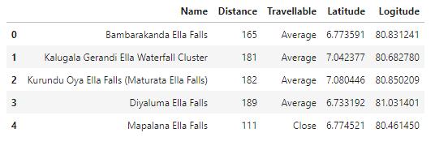
Data Set
Self Defined Accurate Data set with Waterfall Name,Distance from Colombo and Location.
Initial Dataset was modified with a Column named “Travelability” by categorizing the distances.

Slide 4
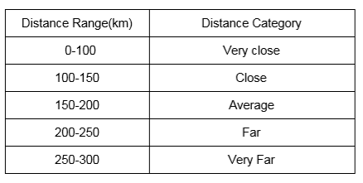
Distance Ranges
Distance was categorized in to ranges as follows.

Slide 5
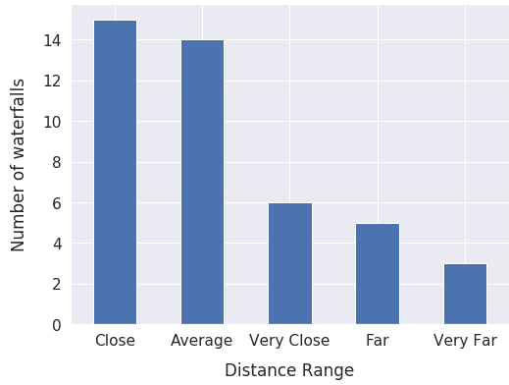
Distance Analysis
Close and average range have highest number of waterfalls.
More than 50%
Of the waterfalls are in averagely close range.

Slide 6
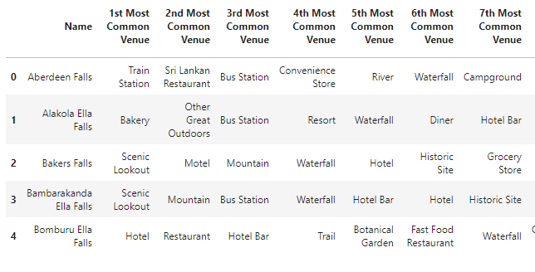
Foursquare Dataset
Foursquare dataset was used to find nearby venues.
It was modified to get the top 10 venues for each location.
Getting the quantity of each venu category for each waterfall location.
Getting the mean value of above dataframe
Categorizing the top 10 locations per each.

Slide 7
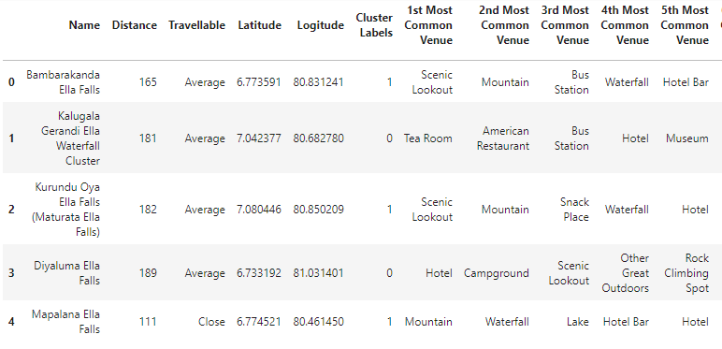
Running k-means to cluster the neighborhood into 3 clusters.
Total Number of three Clusters were defined and the tables were merged.

Slide 8
Cluster Defining
Comfort Zone Lover
All the facilities and venues are nearby.
Nature Lover
More natural scenes are nearby
Visit and Come
Can be used to as a day trip

Slide 9
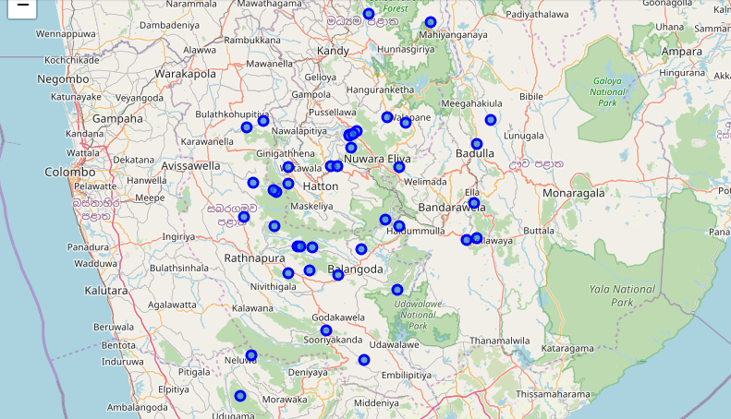
Maps

Slide 10
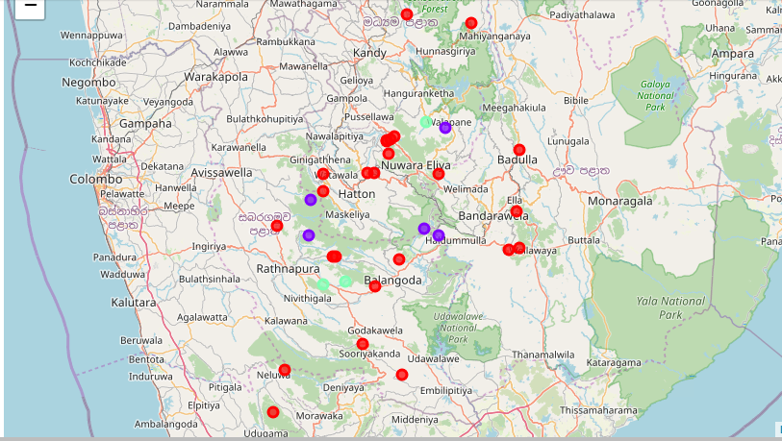

Slide 11
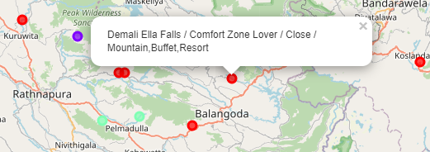
Maps Insights
Most Number of Venues are in Comfort Zone Category.
Nature Lovers have some good specific venues.
Even though the Number Is Low Visit and Come category lovers can use Comfort Zone category as they are pretty much similar.
Marker Insights shows name,category,distance Range,Top 3 nearby venues

Slide 12
Discussion
Advantages
Travellers and guides can select the preferred location by distance and venue preference.
Businessman can select a ideal place to start their business regarding tourism.
Local tourists can also use this project to plan their trips.
All the travellers have a good platform to plan their time and experience wisely by this project.

Slide 13
Conclusion
Sri Lanka is one of the best countries to observe and visit waterfalls.
Any type of traveller can find their favourite waterfall location in Sri Lanka.
Travellers, Guides can use this project to find their favourite waterfall venue by distance or by their tastes nearby.

Slide 14
Thank You

